Slide 1


AI Meeting Minutes Generator
Smart Meeting Assistant — Transforming Audio into Actionable Minutes
GROUP MEMBERS
Faiza Malik 2507-1844
Sangkari Maniyarasu 2503-0675
Ridhwan Mahamud Arpon 2507-1809
Ahmed Estayak 2507-1924
Notes:
1

Slide 2
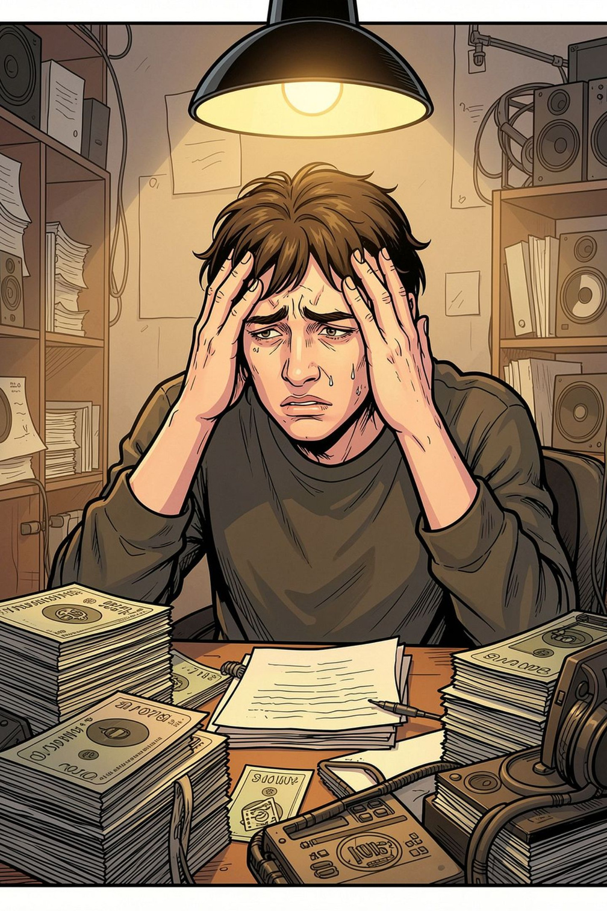

The Problem
⏱ Time-Consuming
⚠️ Inconsistent
Participants spend significant time manually replaying recordings and transcribing content
Manual formatting leads to uneven, unreliable meeting minutes across the team
❌ Missed Items
Critical action items and decisions get overlooked in the manual process
Notes:
2

Slide 3

Our Solution
One Automated Pipeline
The AI Meeting Minutes Generator combines Speech-to-Text with AI text generation to transform raw audio into polished, structured meeting minutes — automatically.
Upload audio
Generate transcript
Get structured minutes
Notes:
3

Slide 4

How It Works: The Pipeline
Upload Audio
Summarize & Actions
Transcribe Audio
Each stage is automated — no manual intervention required between steps.
Notes:
4

Slide 5
Key Features
Meeting Summary
Action Items
Key Discussion Points
Concise AI-generated overview capturing the key discussion points, decisions made, and conclusions reached
Automatically extracted follow-up tasks, with the responsible person and deadline when explicitly mentioned.
Important topics and themes surfaced from the meeting, organized for quick review
Notes:
5

Slide 6
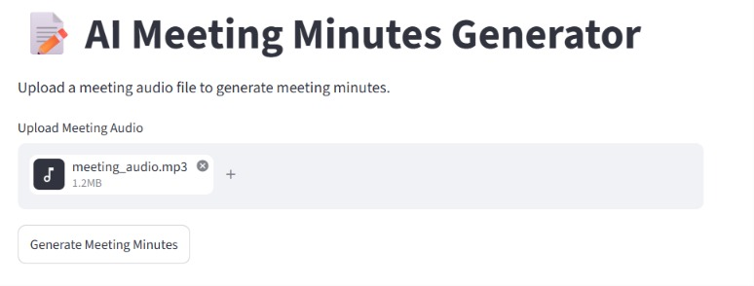

Demo: Upload Screen
Simple & Intuitive Interface
The web interface is designed for ease of use — The web interface is designed for ease of use.
  Drag-and-drop or browse to upload audio
  Supports common meeting audio formats
  One-click processing to launch the full pipeline
Designed so any teammate can use it without a tutorial.
Notes:
6

Slide 7
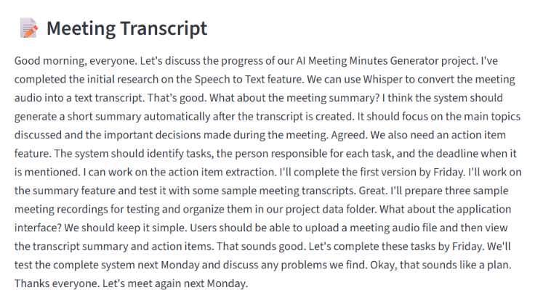
Demo: Generated Transcript
Full Speech-to-Text Output
The meeting audio is converted into a readable text transcript. and displayed in a clean, readable format — fully searchable and ready for downstream analysis.
  Generated transcript displayed on screen.
  Readable and easily scannable
  Foundation for summary and action item extraction
Notes:
7

Slide 8
Demo: Meeting Summary & Action Items
📝 AI-Generated Summary
✅ Action Items Extracted
💬 Key Discussion Points
A concise overview of meeting content — highlights decisions made and conclusions reached.
Follow-up tasks identified directly from the conversation, with assigned person and deadline pulled when explicitly mentioned in the recording.
Important topics surfaced and organized, giving anyone who missed the meeting an instant understanding of what was covered.
Notes:
8

Slide 9

Results & Prototype Testing
✔ Successful Transcription
✔ AI-Generated Summary
The system generated a concise summary based on the transcript.
Meeting audio was successfully converted into a readable transcript.
✔ Action Item Extraction
The system identified tasks and deadlines mentioned in the meeting.
Notes:
9

Slide 10

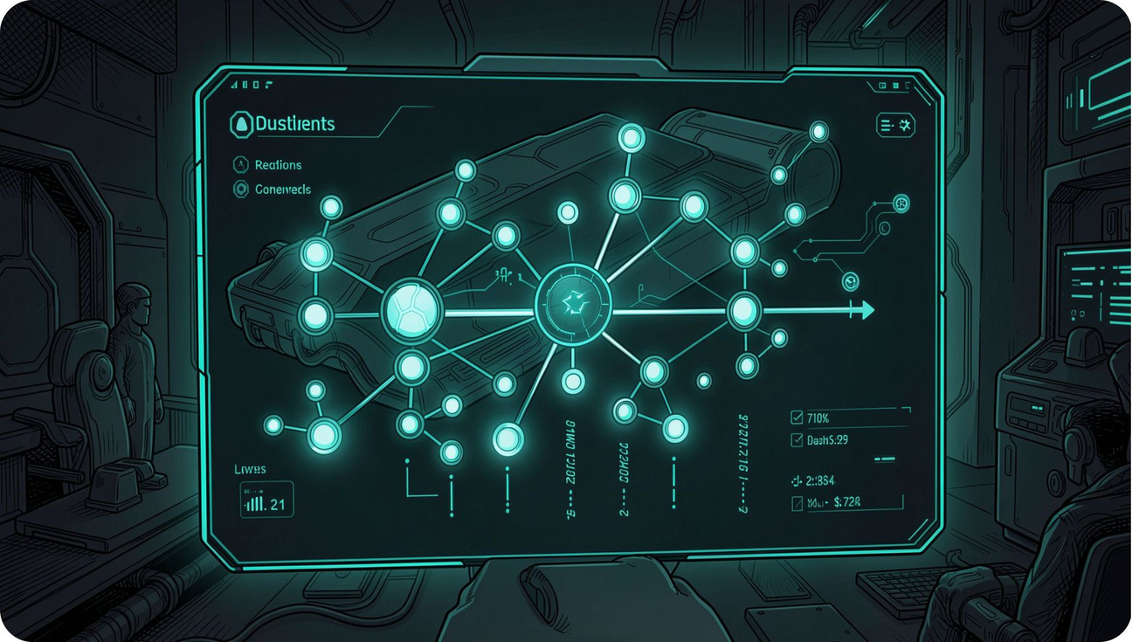
What's Next
01
Speaker Identification
Label each transcript line by speaker name automatically
02
Export Options
Download minutes as PDF, Markdown, or integrate with Notion and Slack
03
Real-Time Processing
Generate minutes live during the meeting, not after
Thanks for watching! Questions? Let's chat about the demo or the tech behind it.
Notes:
10

